Slide 1
OAG training on
Journey of IPSAS implementation for GoR
Facilitator: Accountant General Office

Slide 2


International Public Sector Accounting Standard (IPSAS)
What is IPSAS?
Set of standards developed by IPSASB as best practice for the public sector organizations.
IPSAS Cash or IPSAS Accrual Basis

Slide 3
Number of IPSAS Issued to date
Category | IPSAS | Title | Effective Date
General Purpose Financial Statements | IPSAS 1 | Presentation of Financial Statements | Jan 1, 2008
 | IPSAS 2 | Cash Flow Statements | Jan 1, 2008
 | IPSAS 3 | Accounting Policies, Changes in Estimates & Errors | Jan 1, 2008
 | IPSAS 4 | Effects of Changes in Foreign Exchange Rates | Jan 1, 2008
 | IPSAS 5 | Borrowing Costs | Jan 1, 2008
Revenue & Non-Exchange Transactions | IPSAS 47 | Revenue | Jan 1, 2008
Financial Instruments | IPSAS 28 | Financial Instruments: Presentation | Jan 1, 2013
 | IPSAS 30 | Financial Instruments: Disclosures | Jan 1, 2013
 | IPSAS 41 | Financial Instruments (replaces 29) | Jan 1, 2023
Consolidation & Investments | IPSAS 34 | Separate Financial Statements | Jan 1, 2017
 | IPSAS 35 | Consolidated Financial Statements | Jan 1, 2017
 | IPSAS 36 | Investments in Associates & Joint Ventures | Jan 1, 2017
 | IPSAS 37 | Joint Arrangements | Jan 1, 2017
 | IPSAS 38 | Disclosure of Interests in Other Entities | Jan 1, 2017
 | IPSAS 40 | Public Sector Combinations | Jan 1, 2019
Employee Benefits & other expenses | IPSAS 39 | Employee Benefits | Jan 1, 2018
 | IPSAS 42 | Social Benefits | Jan 1, 2022
 | IPSAS 49 | Retirement Benefit Plans | Jan 1, 2026
 | IPSAS 48 | Transfer Expenses | Jan 1, 2026
Category | IPSAS | Title | Effective Date
Assets | IPSAS 12 | Inventories | Jan 1, 2008
 | IPSAS 14 | Events After Reporting Date | Jan 1, 2008
 | IPSAS 16 | Investment Property | Jan 1, 2008
 | IPSAS 19 | Provisions, Contingent Liabilities & Contingent Assets | Jan 1, 2008
 | IPSAS 20 | Related Party Disclosures | Jan 1, 2008
 | IPSAS 21 | Impairment of Non-Cash-Generating Assets | Jan 1, 2008
 | IPSAS 26 | Impairment of Cash-Generating Assets | Jan 1, 2009
 | IPSAS 27 | Agriculture | Jan 1, 2011
 | IPSAS 31 | Intangible Assets | Jan 1, 2011
 | IPSAS 32 | Service Concession Arrangements: Grantor | Jan 1, 2014
 | IPSAS 43 | Leases (replaces 13) | Jan 1, 2025
 | IPSAS 44 | Non-current Assets Held for Sale & Discontinued Ops | Jan 1, 2025
 | IPSAS 45 | Property Plant and Equipment | Jan 1, 2025
 | IPSAS 46 | Measurement | Jan 1, 2025
 | IPSAS 50 | Exploration & Evaluation of Mineral Resources | Jan 1, 2025
First-time Adoption | IPSAS 33 | First-time Adoption of Accrual IPSAS | Jan 1, 2017
Special Topics | IPSAS 18 | Segment Reporting | Jan 1, 2008
 | IPSAS 24 | Presentation of Budget Information in FS | Jan 1, 2008
 | IPSAS 22 | Disclosure of Information about the GGS | Jan 1, 2008

Slide 4
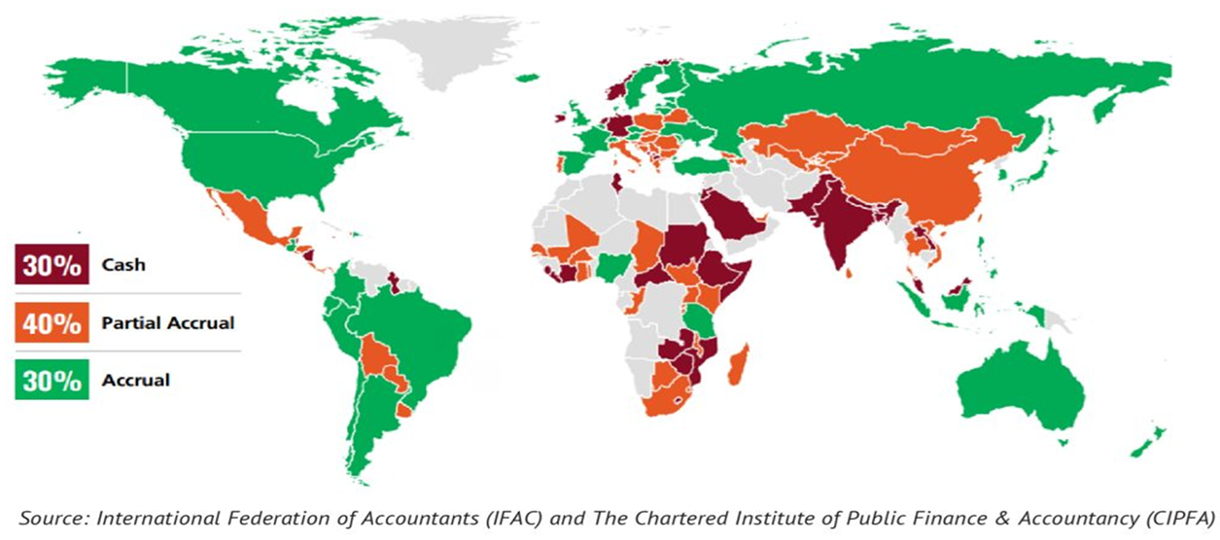
Accrual IPSAS adoption globally

Slide 5





Journey of IPSAS implementation for GoR
GAAP
FY
2006/07 -2008/09
IPSAS CASH BASIS
MODIFIED
FY
2009/10 - 2017/18
IPSAS ACCRUAL
MODIFIED
FY
2018/19 - 2022/23
ACCRUAL
Baseline
FY 2023/24
IPSAS ACCRUAL
FY 2024/25

Slide 6
The GoR IPSAS Accrual Project
IFMIS upgrades;
PFM Law revised:
CoA updates;
Progressive to-date
First Consolidated Accrual Financial Statements
Fy 2023/24
Setting up of Project Governance Structure
2019
IPSAS ACCRUAL
Per IPSAS 33
Fy 2024/25/26/27
Securing resources
Asset & Liability Identification;
Valuation & Recognition
Fy 2022/23/24
Modified cash IPSAS
Development of IPSAS Accrual Blueprint
2018

Slide 7
What is IPSAS 33?
First-time Adoption of Accrual Basis IPSAS
Issued by IPSASB in 2017
Based on a transitional approach

Slide 8



Transitional Pathway by IPSAS 33
Cash Basis
Transitional
Full
Accrual
Limited view of Financial Position.
Low compliance to accrual IPSAS Standards
Gradual recognition of assets and liabilities.
Complete compliance with all IPSAS standards

Slide 9

Transitional vs Big Bang
Full IPSAS compliance from date of adoption
Transitional under IPSAS 33
Requires historical data for all assets and liabilities recognized
Allows temporary exemption from full compliance
Transitional
Vs
Big Bang
Required restatement of comparative period
Allows for deemed cost for initial recognition
Best for entity with all data at date of recognition
Restatement not required for assets and liabilities recognized during transitional period
Full retrospective/big bang
Best for governments due to complexity of valuations, capacity & systems

Slide 10
More features of IPSAS 33
Applies to first time adopters only.
Transitional period of 3 years.
Allows for certain exemptions.
Recognition & Measurement Relief.
Consistent Application of Exemptions.
No Offsetting of Exemptions.
Mandatory Disclosure Requirements.
Progressive Asset & Liability Recognition.
Does Not Affect Comparative Information Before Adoption Date.
Linked to Other IPSAS Standards.
Notes:
Applies to First-time Adopters Only
– Specifically designed for entities moving from cash or modified cash basis to accrual IPSAS.
Transitional Period of up to 3 Years
– Maximum time allowed to achieve full compliance after adoption date.
Allows Certain Exemptions
– Entities may defer full recognition and/or measurement of specified assets and liabilities during transition.
Recognition & Measurement Relief
– Permits deemed cost (fair value or historical cost) for initial asset valuation.
Consistent Application of Exemptions
– Chosen exemptions must be applied consistently across reporting periods and asset classes.
No Offsetting of Exemptions
– Exemptions cannot be netted off or used to conceal non-compliance in other areas.
Mandatory Disclosure Requirements
– Entities must disclose items subject to exemption, reasons, and expected timeline for full recognition.
Progressive Asset & Liability Recognition
– Allows phased-in recording of infrastructure, heritage assets, financial instruments, etc.
Does Not Affect Comparative Information Before Adoption Date
– Transitional adjustments are applied prospectively from adoption date.
Linked to Other IPSAS Standards
– Works alongside IPSAS 1, 17, 31, 41, and others for measurement, presentation, and disclosure rules.

Slide 11
How GoR has applied IPSAS 33
Elected for 3 year transitional period
1st transitional financial statement FY 2024/25
01
Elected for 3 year transitional period
Exemption of full recognition
Incremental recognition of assets and liabilities
Disclosure of exempted assets and liabilities
02
03
Measurement relief
Opted for deemed cost to be fair value or historical cost for legacy assets
Notes:
Applies to First-time Adopters Only
– Specifically designed for entities moving from cash or modified cash basis to accrual IPSAS.
Transitional Period of up to 3 Years
– Maximum time allowed to achieve full compliance after adoption date.
Allows Certain Exemptions
– Entities may defer full recognition and/or measurement of specified assets and liabilities during transition.
Recognition & Measurement Relief
– Permits deemed cost (fair value or historical cost) for initial asset valuation.
Consistent Application of Exemptions
– Chosen exemptions must be applied consistently across reporting periods and asset classes.
No Offsetting of Exemptions
– Exemptions cannot be netted off or used to conceal non-compliance in other areas.
Mandatory Disclosure Requirements
– Entities must disclose items subject to exemption, reasons, and expected timeline for full recognition.
Progressive Asset & Liability Recognition
– Allows phased-in recording of infrastructure, heritage assets, financial instruments, etc.
Does Not Affect Comparative Information Before Adoption Date
– Transitional adjustments are applied prospectively from adoption date.
Linked to Other IPSAS Standards
– Works alongside IPSAS 1, 17, 31, 41, and others for measurement, presentation, and disclosure rules.

Slide 12
GoR transitional timeline
Full IPSAS Compliance Financial Statements.
Accrual Statements prepared but not under IPSAS 33.
2nd Transitional Financial Statements.
2023/24
2025/26
2027/28
2024/25
2026/27
First year under IPSAS 33.
1st Transitional Financial Statements prepared.
3rd Transitional Financial Statements.

Slide 13
 |  |  | FY 2025/26 & 2026/27 – IPSAS 33
ZB |  |  | Indoor assets of subsidiary entities - public schools. | ZB
ZA |  |  | Service concession assets and liabilities; and | ZA
Z |  |  | Grant liabilities and assets; | Z
Y |  |  | Natural resources - values reliable; | Y
X |  |  | Provisions, Contingent assets and liabilities; | X
W |  |  | Employee benefits (long term benefits); | W
V |  |  | Leased assets and liabilities; | V
U |  |  | Valuables; | U
T |  |  | Infrastructure assets – ALL; | T
S |  |  | Heritage assets – ALL; | S
R |  | FY 2024/25 – IPSAS 33 | Biological assets – plants & PPE | R
Q |  | Heritage assets - buildings; | Heritage assets - buildings; | Q
P |  | Investment Property - Land & buildings | Investment Property - Land & buildings | P
O |  | Inventory materials and supplies; | Inventory materials and supplies; | O
N | FY 2023/24 | Financial assets and liabilities - from taxes; | Financial assets and liabilities - from taxes; | N
M | Employee benefits (short term benefits). | Employee benefits (short term benefits). | Employee benefits (short term benefits). | M
L | Loans and direct borrowings; | Loans and direct borrowings; | Loans and direct borrowings; | L
K | Inventories - strategic stocks; | Inventories - strategic stocks; | Inventories - strategic stocks; | K
J | Intangible Assets | Intangible Assets | Intangible Assets | J
I | Biological assets - animals; | Biological assets - animals; | Biological assets - animals; | I
H | Financial Investments; | Financial Investments; | Financial Investments; | H
G | Infrastructure assets - road networks; | Infrastructure assets - road networks; | Infrastructure assets - road networks; | G
F | Machinery Equipment; | Machinery Equipment; | Machinery Equipment; | F
E | Office Equipment; | Office Equipment; | Office Equipment; | E
D | ICT Equipment; | ICT Equipment; | ICT Equipment; | D
C | Transport Equipment | Transport Equipment | Transport Equipment | C
B | Buildings; | Buildings; | Buildings; | B
A | Land; | Land; | Land; | A
GoR recognition strategy
under IPSAS 33
(See Appendix 1 YECP)

Slide 14
Accounting for NCA and Inventory

Slide 15

Topics
Recognition of Legacy and Newly acquired Non-Current Assets
Depreciation of Non-Current Asset
Derecognition of Non-Current Asset
Recognition of Legacy Inventory

Slide 16
Recognition of Legacy Non-Current Assets
Non-current assets shall be measured at historical cost where reliable cost information is available.
Where such information is not available, the entity shall measure the asset at fair value, which will be used as deemed cost in accordance with IPSAS 33;
Legacy NCA are recognized and adjusted against accumulated surplus or deficit.

Slide 17
Recognition of Legacy Non-Current Assets
    Recognition of cost/fair value of assets
    Debit: Relevant non-current assets xxxx
Credit: Opening bal reserve account of the relevant NCA xxxx
Recognition of accumulated depreciation(NCAs of before June 25)
Debit: Opening bal reserve account of the relevant NCA xxxx
Credit: Accumulated depreciation of non-current assets xxxx
(With the cumulative amount of depreciation as at the entity’s date of recognition of the legacy asset.)

Slide 18
Recognition of Legacy Non-Current Assets
    Example
    Entity xyz had Office Furniture of Frw 3,000,000 that was acquired on 1st January 2023 and the entity omitted to capture the asset in FY 2023/24 and decided to recognize on 1 July 2024 (i.e in FY 2024/25). Following will be accounting entries:
    Recognition of legacy asset at cost
    Dr Office Furniture at cost 3,000,000
    Cr Opening Bal Reserve 3,000,000
    Recognition of accumulated depreciation on legacy asset
    Dr Opening Bal Reserve 900,000
    Cr Accumulated Depreciation (3,000,000/60 months*18 months) 900,000
    NB: Furniture has a 5 year (60 months) useful life. Period of accumulated depreciation from 1/1/2023 to 1/7/2024 will be 18 months

Slide 19
Newly acquired NCA transactions for financial year 2024/25
Newly acquired assets during financial year 2024/25 are accounted for in line with Accrual IPSAS rules subject to the exemptions laid out in Appendix 1 of YECP.
Non-current asset acquired through purchase or expropriation shall be recognized at its cost.
Non-current asset acquired through donation or transfer shall be recognized at its cost/fair value/carrying amount.
No non-current asset capitalization threshold shall be applied for entities using IFMIS during the period financial year 2024/25.
All non-current asset acquired during financial year 2024/25 should be registered in IFMIS/any other systems and depreciation procedures should be initiated periodically.

Slide 20
Recognition of Newly Acquired Assets & Depreciation
    Recognition of cost/fair value of assets(FY24-25)
    Debit: Relevant non-current asset class xxxx
Credit: Accounts Payable/Bank account xxxx
Depreciation (FY24-25)
Debit: Depreciation expense xxxx
Credit: Accumulated depreciation account xxxx

Slide 21
Recognition of Newly Acquired Assets & Depreciation
    Example
    Entity acquired a computer on 28th May 2025. Following accounting entries will be created in the GL on date of acquisition:
    Dr ICT Equipment at cost 1,000,000
    Cr Accounts Payable 1,000,000
    Next step: Asset should be registered in IFMIS asset registered and depreciated.
    See slides practical example.

Slide 22
Depreciation
The Migrated Legacy non-current assets with limited useful lives shall be depreciated in the 2024/25.
Depreciation shall be computed using the straight-line method over useful life.
      Depreciation = Cost or Fair value
            Useful life or Remaining useful life
See appendix 2 of YECP –Useful lives allocated to NCAs.
Date of Acquisition:
For assets recorded at historical cost: the original date the entity acquired the asset.
For assets recorded at fair value: date of valuation

Slide 23
Current year depreciation of legacy NCA
    Example
    Entity had Office Furniture of Frw 3,000,000 that was acquired on 1st January 2023 and the recognized on 1st July 2024 when cost data became available.
    Following will be depreciation accounting entries in FY 2024/25:
    Recognition of legacy asset at cost – 1st July 2024
    Dr Office Furniture at cost 3,000,000
    Cr Opening Bal Reserve 3,000,000
    Recognition of accumulated depreciation on legacy asset – 1st July 2024
    Dr Opening Bal Reserve 900,000
    Cr Accumulated Depreciation (3,000,000/60 months*18 months) 900,000
    Recognition of depreciation for year – 1st July 2024 to 30th June 2025
    Dr Depreciation 600,000
    Cr Accumulated Depreciation (3,000,000/60 months*12 months) 600,000
    NB: Furniture has a 5 year (60 months) useful life. Period of accumulated depreciation from 1/1/2023 to 1/7/2024 will be 18 months

Slide 24
Recognition of Newly Acquired Assets & Depreciation
    Example
    Entity acquired a computer on 28th May 2025. Following accounting entries will be created in the GL for FY 2024/25 as at 30th June 2025:
    Recognition of cost/fair value of assets – date of acquisition
    Dr ICT Equipment at cost 1,000,000
    Cr Accounts Payable 1,000,000
    Recognition of depreciation - monthly
    Dr Depreciation (1,000,000/36months * 2months) 55,556
    Cr Accumulated depreciation 55,556
    See slides practical example.

Slide 25
Fully depreciated assets
Fully depreciated non-current assets are assets that had a carrying amount of Frw 0 as at 30th June 2025.
Fully depreciated assets which are still in use and providing service potential and remain in good operational condition, should:
    Remain in the financial statements at a carrying amount of zero; and
    Be maintained in the asset register

Slide 26
Recognition of Legacy Inventory
    Recognition of cost/fair value of assets
    Debit: Relevant inventory xxxx
Credit: Opening bal reserve account of the relevant inventory xxxx
Reversing inventory balance already expensed in FY 2024/25
Debit: Opening bal reserve of the relevant inventory xxxx
Credit: Relevant expense category xxxx

Slide 27
Recognition of Legacy Inventory
    Recognition of cost/fair value of assets
    Debit: Relevant inventory xxxx
Credit: Opening bal reserve account of the relevant inventory xxxx
Reversing inventory balance already expensed in FY 2024/25
Debit: Opening bal reserve of the relevant inventory xxxx
Credit: Relevant expense category xxxx

Slide 28
Recognition of Legacy Inventory
    Strategic stock was recognized in FY 2023/24.
    Legacy inventory shall be recognized under accrual basis in FY 2024/25 for the first time. Categories include Materials and Consumables.

Slide 29
Recognition of Legacy Inventory
    Example
    Recognition of Legacy Inventory
    Dr: Inventory 640
    Cr: Opening Bal Inventory 640
    Reversal of expensed inventory
    Dr: Opening bal inventory 240
    CR: Relevant Expense line 240
Stock as at 30th June 2025
Bin card name: Stapler
Unit | Quantity | Date of acquisition | Unit Price | Total Amount
Stapler 2 | 1 | 30-Apr-24 | 400 | 400
Stapler 3 | 1 | 20-Jun-25 | 240 | 240
Total as at 30 June 2025 | 2 |  |  | 640
 |  | Weighted Average Price |  | 320
Since Stapler 3 was already expensed in FY 2024/25 and has now been recognized as an asset (inventory), the expenditure is reversed.

Slide 30
Practical Sessions-IFMIS Demo
Recognition of Legacy Assets in asset register
Recognition of newly acquired non-current assets
Recognition on Legacy Inventory

Slide 31
Year end closing procedures

Slide 32
Overview of FY 2024/25 YECPs
Legal Basis
1
7
Transitional FS FY 2024/25
Termination of expenditure commitments
2
6
Inter-entity Transaction Reconciliations
Transfer of unutilized funds
3
5
Opening Balances
4
Critical reporting deadlines

Slide 33
1. Legal Basis
Legal basis: YECP are issued incompliance to Article 76 of the Organic Law on Public Finance Management No. 002/2022.OL of 12/12/2022;
Financial Year: Financial Year ends 30th June 2025;

Slide 34
2. Termination of expenditure commitments
In accordance with article 54 of the Organic Law on PFM: Any expenditure commitment ends on 30th May of the same fiscal year unless otherwise authorized by the Minister.
Payments in respect of a commitment entered into before the date referred to in Paragraph One of this Article may be effected until 30th June of the fiscal year.
At the end of the last working day of each fiscal year, budget appropriations and all other expenditure authorizations immediately lapse.

Slide 35
3. Transfer of unutilized funds
Any funds that will remain unutilized by the end of the fiscal year for Ministries and Agencies’ zero balances bank accounts shall be transferred back to the OTR ZERO BALANCE ACCOUNT that has the 311302 as GL Code and 1000007575 as bank account.
An IFMIS Functionality ‘Funds transfer transaction' shall be used for the transfer of the unutilized bank balances back to the OTR ZERO BALANCE ACCOUNT and the following cash journal entries shall be generated by the IFMIS in the books of Accounts of the concerned entities:
Debit: Direct Cash Transfers xxx
Credit: Zero balances bank Account xxx

Slide 36
3. Transfer of unutilized funds
Any cheques/Ops or instruction for payment processed and submitted to BNR before 30th June 2025 but remained unpaid (in transit at the National Bank of Rwanda) while funds have been swept back in TSA, Treasury will be able to refund such funds when the entity present to Treasury the request to refund the amount with a copy of the proof of payment as well as a duly certified bank reconciliation.
The refund requests should be submitted to Treasury not later than 31st July 2025.

Slide 37
4. Reporting Requirements
Ref no. | Description | Date | Article of Organic Law on public finance management N° 002/2022.OL of 12/12/2022 | Responsibility
1 | Monthly reports | 20th of the following month | Article 78 | Chief Budget Manager
2 | Submission of Final annual financial statement to MINECOFIN | 15th August 2025 | Article 78 | Chief Budget Manager
3 | Submission of Final annual financial statements to Auditor General | 15th August 2025 | Article 78 | Chief Budget Manager
4 | Submission of consolidated financial statements to Auditor General | 30th September 2025 | Article 79 | Minister

Slide 38
5. Opening Balances
The opening balances for current financial year shall be those that correspond to the closing balances included in the financial statements for the previous FY ended as was submitted to MINECOFIN and Office of Auditor General.
Any changes to the opening balances shall be duly authorized by the Chief Budget Manager and well supported for future reference

Slide 39
6. Inter-entity Reconciliations
Public entities have to carry out direct confirmations from the receiving and sending entity to ensure that both parties have treated the amounts as inter-entity transactions and that the amounts are equal.
At the central/local Government level, the sub-consolidating entities shall ensure that the intra-transfer transactions between the parent and subsidiaries are fully eliminated.

Slide 40
7. Accounts Receivables and Payables
Irrecoverable receivables and payables whose payment is confirmed to be impossible (those last for more than two years in the books of accounts) should be written off. (Ref. to art.105 of M.O and section 11.3 of Public Finance Management Manual).
Debts should be considered for write-off if any of the following conditions apply:
The debtor has died leaving no known estate;
The debtor cannot be located;
The debtor is not resident in Rwanda and there are no means of collection or indication that the debtor has family or business ties that might encourage him to return to Rwanda;
The debtor has disputed liability and the success in collecting is unlikely; v. The debtor is a company that has ceased to operate and has no assets; or
The court has ruled in favour of the debtor to the effect that he/she does not owe the budget entity
It has been proved that the cost of collecting the outstanding debt is more than the amount to be received;

Slide 41
8. Transitional FS FY 2024/25
The financial statements for the financial year 2024/25 will be the first transitional financial statements prepared under the accrual basis complying with International Public Sector Accounting Standards (IPSASs) framework.
These statements incorporate selected transitional exemptions in accordance with IPSAS 33 – First-time Adoption of Accrual Basis IPSAS, which allow for the phased recognition and measurement of specific classes of assets and liabilities over a three-year transition period.
This marks a significant milestone in the journey toward full compliance with accrual IPSAS by the end of the permitted transition period in the financial year 2026/27.

Slide 42
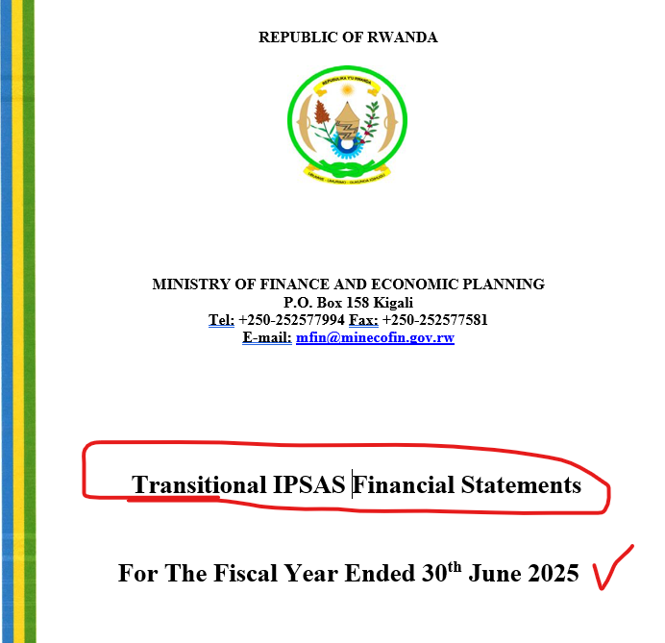

Slide 43
Set of Financial Statements
In accordance with Article 99 and 107 of the Ministerial Order on Financial Regulations, a standard financial reporting template to be used by Public entities shall include the following:
Statement of Financial Performance showing revenues and expenditures (From Note 01 up to Note 33);
Statement of Financial Position showing assets and liabilities (From Note 34 up to 76);
Statement of Changes in Net Assets;
Statement of Cash Flows;
Statement of Appropriation comparing Budget against Actual out-turn;
Statement of Accounting Policies applied in preparing and presenting the financial statements;
Notes to the Financial Statements and schedules relevant to enhancing fair presentation and understandability of the statements (Notes number increased to 76); and
(f) Appropriate disclosures(Reduced): A list of disclosures on the full report and another list of disclosures which are not part of the full report but maintained into the system for further reference.

Slide 44


